Slide 1
Understanding and Using Internet Resources
Chapter 14

Slide 2
Learning Objectives
Discuss the Internet and its available services
Access resources on the Internet and understand its addressing methods
Discuss ways to establish an Internet connection

Slide 3
The Internet
The Internet evolved from the U.S. Department of Defense’s Advanced Research Projects Agency Network (ARPANET)
ARPANET used TCP/IP which became the data communications protocol suite of the Internet
Focus of the Internet has shifted from sharing information among universities and research labs to commerce and communication

Slide 4
The Network Administrator and the Internet
Network administrators can use Internet for variety of reasons:
To gain information about computers and networks
As source for technical assistance
To download software upgrades, patches, and fixes

Slide 5
What’s on the Internet?
Some of the most popular Internet services include:
Chat and instant messaging
Electronic mail (e-mail)
File Transfer Protocol (FTP)
Newsgroups
Telnet
World Wide Web (WWW)

Slide 6
Chat and Instant Messaging
Real-time communication has appeal for applications from virtual classrooms to support groups
Many Web sites offer chats with technical experts, authors, and celebrities
Instant messaging applications let user interact privately
Application include AOL Instant Messenger, Microsoft Chat, ICQ, and IRC

Slide 7
E-Mail
Preferred form of communication for individuals and organizations
E-mail address consists of username@domain name
On the Internet, Simple Mail Transfer Protocol (SMTP) is upper layer protocol that supports e-mail
Multipurpose Internet Mail Extensions (MIME) is standard governing e-mail attachments

Slide 8
File Transfer Protocol Servers
File Transfer Protocol (FTP) is high-level protocol for accessing or depositing files on remote servers
Figure 14-1 shows WS_FTP Pro, a graphical FTP utility
Many Internet browsers include support for FTP file transfer
Figure 14-2 shows Microsoft’s FTP site

Slide 9
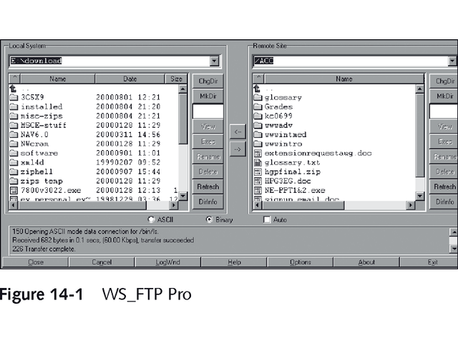
WS_FTP Pro

Slide 10
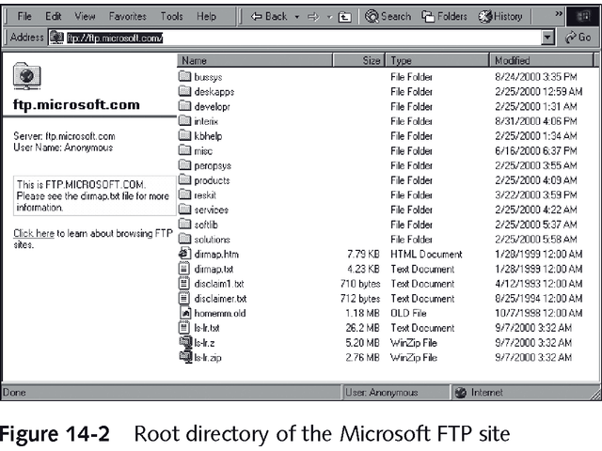
Microsoft’s FTP Site

Slide 11
Newsgroups
Network News Transfer Protocol (NNTP) handles distribution, inquiry, retrieval, and posting of news articles
Over 80,000 public newsgroups available on Internet, with USENET most popular one
May be unmoderated or monitored
Maintain posts for short period of time, called scroll rate

Slide 12
Newsgroups
Must have NNTP client to access newsgroup
Organized in a hierarchical structure, alphabetically by category
Valuable source for news about viruses, system bugs, new software and tools
Can provide “peer-level” technical support
For listing of all available Internet newsgroups, visit groups.google.com

Slide 13
Telnet
Oldest TCP/IP-based service
Lets user run programs, execute commands, and interact with remote system on Internet or any TCP/IP-based network
Most modern operating systems include a Telnet server
Windows NT server must use third party product for Telnet access

Slide 14
World Wide Web
Internet and World Wide Web are not same
WWW is newest Internet service in this chapter
Web consists of millions of documents written in Hypertext Markup Language (HTML)
Can browse using links
Primary protocol is Hypertext Transfer Protocol (HTTP)
Front page of Web site is called home page
Figure 14-3 shows Course Technology’s home page

Slide 15
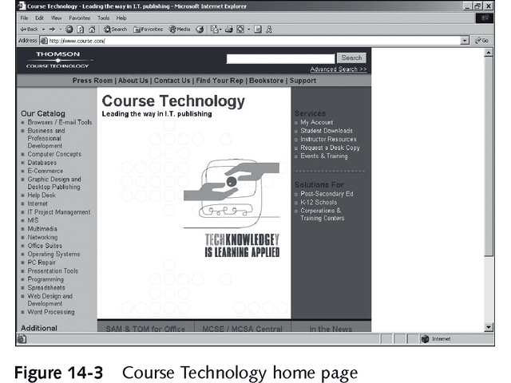
Course Technology’s Home Page

Slide 16
World Wide Web
Use search engine, such as Yahoo or Google, to find Web sites with specific information
Most hardware and software vendors have web sites
Contain product information, updated documentation, new drivers
Table 14-1 shows Web addresses for some hardware manufacturers
Web is rich and useful resource

Slide 17
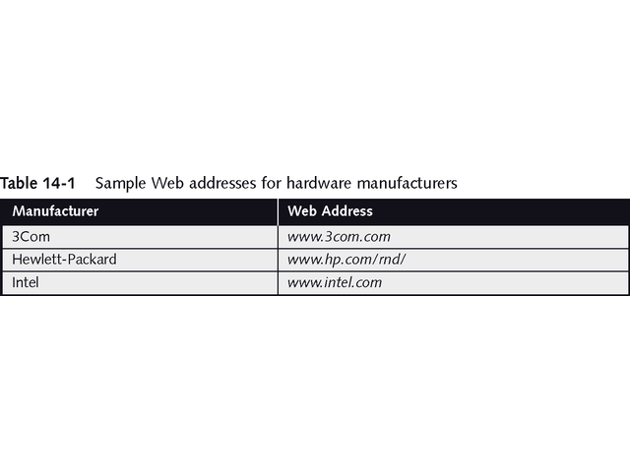
Sample Web Addresses for Hardware Manufacturers

Slide 18
Locating Internet Resources
Internet address lets users navigate Internet
Address usually represented as resource names
Name has corresponding TCP/IP numeric address

Slide 19
Internet Resource Names
Uniform Resource Locator (URL) is address associated with Web-based Internet resource
Includes protocol to use to access it
Protocol is followed by colon, such as HTTP:
Two forward slashes begin the address
Domain name identifies the organization and references a server

Slide 20
Domain Name System (DNS)
DNS protocol resolves symbolic names to corresponding IP addresses
Example: www.microsoft.com references IP address 207.68.156.61
Last element of domain name, called top-level domain, categorizes type of organization
Other domain types may indicate country of origin

Slide 21
Common Domain Types in the United States
.com Commercial organizations or businesses
.edu Educational institutions
.gov Government organizations (except military)
.mil Military organizations
.net Network service providers
.org Other organizations, usually nonprofit

Slide 22
Country-Specific Domains
.au Australia
.fr France
.uk United Kingdom
For complete, geographically organized list of country top-level domain names, visit www.norid.no/domenenavnbaser/domreg.html

Slide 23
Getting a Domain Name
Simple and affordable process
Usually $35/year or less
Numerous Web sites can register your domain name for you
Select unused domain name and top-level name
May also new top-level domain .name to register personal name or e-mail address

Slide 24
Making an Internet Connection
Most users go through Internet Service Provider (ISP) to connect to Internet
ISPs provide dial-up and dedicated links
Dial-up lines using modems are most common
Other relatively inexpensive connections include Integrated Services Digital Network (ISDN), cable modem, and digital subscriber line (DSL)
Large companies and government bodies may use higher bandwidth connections such as DS-3 or ATM

Slide 25
Dial-Up Connections
Dial-up protocols include:
Point-to-Point Protocol (PPP)
Serial Line Internet Protocol (SLIP)
CSLIP, a compressed version of SLIP
PPP is dial-up protocol of choice for ISPs today because it supports these features:
Compression
Error-checking
Dynamic IP addressing

Slide 26
Digital Connection Types
ISDN is digital line for voice or data with speeds up to 128 Kbps
Limitations are cost and availability
Newer digital technologies offer higher bandwidth at lower costs
Cable modems with bandwidth from 150 to 900 Kbps
DSL with bandwidth of 384 Kbps and higher

Slide 27
Connection Considerations
Dial-up and digital connections support single- or multiple-user accounts
Dial-up is generally cheaper and easier to implement
Digital is faster and offers more bandwidth for multiple users
Large organizations may use full-bandwidth DSL, multichannel frame relay, full or fractional T1 links, or even T3 or DS-3 lines

Slide 28
Connection Considerations
Consider security when connecting to Internet
Use filtering and access controls
Proxy server is software program that acts as gateway between network and Internet
Firewall sits between external Internet and in-house internal networks

Slide 29
Chapter Summary
The Internet has become everyday part of life
Network administrators use its vast resources to retrieve drivers and software updates, get technical support, read periodicals, and discuss problems and ideas through newsgroups
Domain names and URLs associated with particular resources enable users to locate information on the Internet
Setting up Internet connection is simple

Slide 30
Chapter Summary
Be sure your organization’s requirements for bandwidth and security are being satisfied
Key services on Internet include:
FTP for file transfer
HTTP for Web access
Telnet for remote access
SMTP for transferring e-mail messages
NNTP for access to newsgroups
ICQ and IRC for instant messaging and chat access

Slide 31
Chapter Summary
Network administrators use Internet services to find technical information, software, and updates
Users normally connect to Internet using modem or low-end digital subscriber line such as ISDN, cable modem, or partial-bandwidth DSL
Businesses often require more bandwidth and use technologies such as frame relay, full-bandwidth DSL, or full or fractional T1 lines to connect to the Internet

Slide 32
Chapter Summary
Maintaining security is important when exposing information resources on the Internet
Most organizations use firewall/proxy server combinations to isolate internal networks from external Internet or other public networks

